Slide 1


Organization: Strategy and Project Selection
(25CPE4602)
Lecture 2
Dr. Zahraa Ismail

Slide 2
Definitions
Stakeholders: People or organizations; who will be affected
(positively or negatively) by your project at any point in its life
cycle, and their input can directly impact the outcome.
It's essential to practice good stakeholder management and
continuously communicate to collaborate on the project.
Examples:
  Members of a project team.
  Project managers.
  Executives.
  Project sponsors
  Customers
  Users.
2

Slide 3
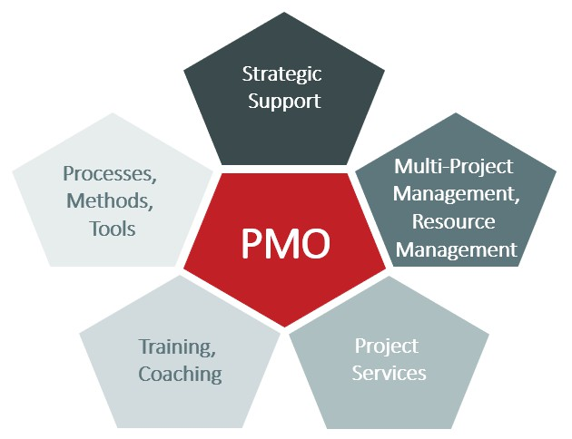
Project Management Office
PMO is a permanent organizational unit that is centrally responsible for all projects within a company or a department in the context of multi-project management
.
Notes:
A PMO(Project Management Office) is a centralized body that supports the successful management of projects. It helps set up project management standards, resources, and oversight to ensure on-time, in-scoped, and budgeted completion of projects.
PMOs can be supportive or directive depending upon the needs of an organization.
Governance and Standards: The PMOs create and maintain a set of standardized methodologies (Agile, Waterfall, etc.), so that there is an ensured consistency in the managing projects.
Resource Management: The PMO also handles the resource allocation across the various projects so that the teams are provided with all the necessary tools and personnel on board.
Performance Tracking: They track progress based upon KPIs on timelines, costs, and quality; hence they make sure that all the projects are working on the proposed plan.
Risk Management: A PMO identifies risks way back in the project lifecycle and comes up with strategies to manage the same, which would therefore reduce the chances of project failure.
Training and Support: PMOs provide training on project management tools and techniques which helps project managers as well as teams enhance their skills.
Prioritization of Projects: PMOs help senior leadership to prioritize projects that align with strategic goals so that high-value initiatives gain needed resources.

Slide 4
Types of PMO(Project Management Office)
Here are the following types of PMO(Project Management Office):
Supportive PMO: This PMO guides, offers templates and training to the project manager, but enforces only on a less rigid scale. The approach takes the consultative route; thus, it is more lenient for teams.
Controlling PMO: The controlling PMO develops and enforces frameworks. There are clear standards set by this PMO and formulated standards to be strictly followed by teams while expecting minimum oversight compared to that of the supporting PMO.
Directive PMO: Here, the PMO entirely dominates projects. It controls all key decision-making and is responsible for the execution and outcome of the projects.
Notes:
Advantage of a PMO(Project Management Office)
Here are the following Advantage of a PMO(Project Management Office):
Process Standardization: A PMO ensures standard processing of all its projects following a uniform methodology that obviates confusion, enhances communication, and leads to predictable results.
It helps in centralizing the management of resources and ensuring best practices, reducing redundancy and avoiding misallocation of resources, which often leads to effective project execution.
Probable Risk of Enhancing Success: PMOs identify risks early. PMOs deal with well-thought-out strategies for an early solution to risks, which heightens the probability of successful execution.
More Accountability: PMOs make the project manager and teams responsible for what they do and what they don't do. Reportings are very frequent, so monitoring is transparent and prevents blockages.
Alignment with Strategic Objectives: The role of a PMO is to ensure that every project makes value towards the larger objectives of the organization. In doing this, the value brought by the overall projects to the company is increased.
Knowledge Sharing: PMOs create the opportunity to share lessons learned and best practices across the organization. This can drive a continuous process improvement in project management processes.
Disadvantages of a PMO
Here are the disadvantage of PMO(Project Management Office):
Resistance to Change: Introducing a PMO can resist as there may be an apprehension from personnel that the new process is increasing bureaucracy and reducing flexibility.
Increased Overhead : Enabling and operating a PMO incurs cost in terms of skilled human resources, tools, and infrastructure, which has the effect of increasing overhead costs of an organization.
Potentially Bureaucratic: PMOs become ridiculously bureaucratic because the management of a PMO may lead to red tapism, if not acutely managed, thereby hindering innovation and slowing the executions of projects due to unnecessary paper work and adherence to rules of procedures.
Scalability Issues: An approach of one size fits all may not work for all projects, especially in a very diversified or a very fast changing environment. PMOs need to be sensitive to the needs of different types of projects.
Decision-Making Slowdown: Central oversight sometimes slows down decision making-processes-in directive PMOs in particular, where all decisions are filtered and approved by the PMO.

Slide 5
Applications of a PMO
Large Enterprises
Highly Regulated Industries
Organizations Under Transformation
Project Intensive Organizations
Global Teams
Notes:
Large Enterprises: Companies that have many sophisticated projects spanning boundaries of departments would be ideal for a PMO in the pursuit of harmonizing departmental work towards standardization.
Highly Regulated Industries: In finance, healthcare, government, and similar industries where the basic requirement is compliance with legal and regulatory parameters, PMOs can ensure that all projects align within the premise of such regulations.
Organizations Under Transformation: The company is undergoing a transformation process, such as a merger or acquisition, or the introduction of new technologies. In such situations, PMOs ensure delivery of projects that are consistent with and in support of organizational strategic objectives.
Project Intensive Organizations: Companies undertaking many projects, like software companies, construction firms, and engineering companies will benefit more from a PMO in ensuring their centralized control and resource allocation.
Global Teams: An organization with dispersed teams benefits from a PMO due to standardization and coordination, which in effect enables effective communication in a dispersed organization across locations and time zones.

Slide 6
Stratgey
It means deciding how the organization will compete. Organizations use projects to convert strategy into new products, services. For example, Intel’s major strategy is “differentiation”. Its projects target innovation and time to market. It is directing its strategy toward specialty chips for products other than computers.
Aligning projects with the strategic goals of the organization is crucial for project success.
How can an organization ensure this link and alignment? The answer requires integration of projects with the strategic plan.
Project managers need to understand their organization’s strategy so that they can make appropriate decisions and adjustments.

Slide 7
Strategic Options (1/3)
Low cost Strategy
This strategy is most likely to be achievable in large markets, requiring large-scale capital investment, where production or service volumes are high and economies of scale can be achieved from long runs.
  Operating efficiencies
  Product redesign
  Product standardization
  Economies of scale
Notes:
من المرجح أن تكون هذه الإستراتيجية قابلة للتحقيق في الأسواق الكبيرة، والتي تتطلب استثمارات رأسمالية ضخمة، حيث تكون أحجام الإنتاج أو الخدمات عالية ويمكن تحقيق اقتصاديات الحجم من الإنتاج بكميات كبيرة.

Slide 8


Strategic Options (3/3)
Differentiation Strategy
Deep understanding of what customers really want and need, and more importantly, what they are prepared to pay more for.
Apple’s opening strategy was based around a ‘fun’ operating system based on icons.
Focus Strategy
Concentration on a narrow specific segment either with cost advantage or differentiation.
IKEA is a good example
6
Notes:
فهم عميق لما يريده العملاء حقًا ويحتاجونه، والأهم من ذلك، ما هم مستعدون لدفع المزيد مقابله.كانت استراتيجية آبل الابتدائية مبنية على نظام تشغيل 'مرِح' قائم على الرموز
لتركيز على شريحة محددة ضيقة سواء مع ميزة التكلفة أو التمايز.

Slide 9
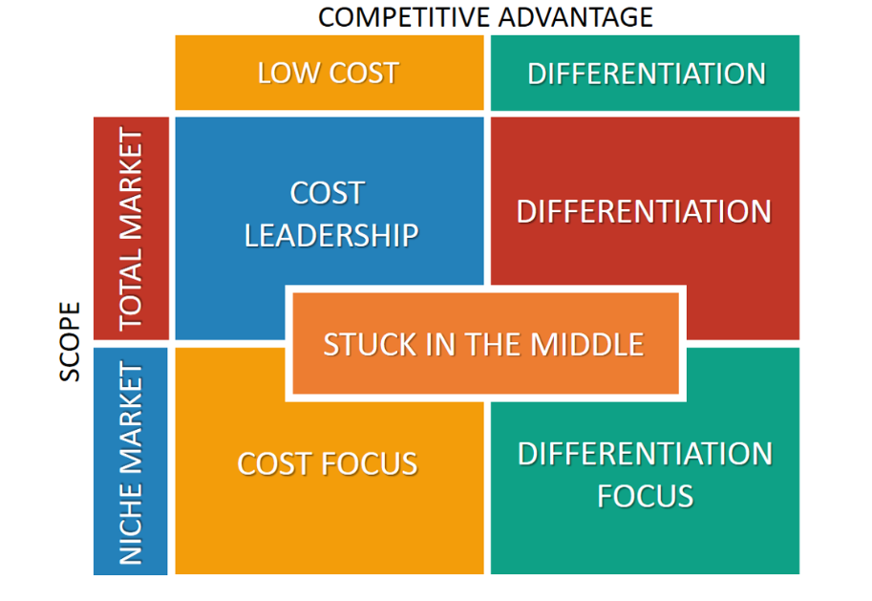
Notes:
Differentiation
Differentiation is a type of competitive strategy with which a company seeks to distinguish its products or services from that of competitors: the goal is to be unique. A company may use creative advertising, distinctive product features, higher quality, better performance, exceptional service or new technology to achieve a product being perceived as unique. A differentiation strategy can reduce rivalry with competitors if buyers are loyal to a company’s brand. Companies with a differentiation strategy therefore rely largely on customer loyalty. Because of the uniqueness, companies with this type of strategy usually price their products higher than competitors. Examples of companies with differentiated products and services are: Apple, Harley-Davidson, Nespresso, LEGO, Nike and Starbucks.
Cost Leadership
Cost Leadership is a type of competitive strategy with which a company aggressively seeks efficient large-scale production facilities, cuts costs, uses economies of scale, gains production experience and employs tight cost controls to be more efficient in the production of products or the offering of services than competitors: the goal is to be the low-cost producer in the industry. A low-cost position also means that a company can undercut competitors’ prices through for example penetration pricing and can still offer comparable quality against reasonable profits. Low-cost producers typically sell standard no-frills products or services. Examples of companies with cost leadership positions are: Southwest Airlines, Wal-Mart, McDonald’s, EasyJet, Costco and Amazon.
Focus
Focus is a type of competitive strategy that emphasizes concentration on a specific regional market or buyer group: a niche. The company will either use a differentiation or cost leadership strategy, but only for a narrow target market rather than offering it industry-wide. The company first selects a segment or group of segments in an industry and then tailors its strategy to serve those segments best to the exclusion of others. Like mentioned, the focus strategy has two variants: Differentiation Focus and Cost Focus. These two strategies differ only from Differentiation and Cost Leadership in terms of their competitive scope. Examples of companies with a differentiation focus strategy are: Rolls Royce, Omega, Prada and Razer. Examples of companies with a cost focus strategy are: Claire’s, Home Depot and Smart.
Stuck in the Middle
A company that tries to engage in each generic strategy but fails to achieve any of them, is considered ‘stuck in the middle’. Such a company has no competitive advantage regardless of the industry it is in. As a matter of fact, such a company will compete at a disadvantage because the ‘cost leader’, the ‘differentiators’ and the ‘focusers’ in the industry will be better positioned to compete. It may be the case, however, that a company that is stuck in the middle still earns interesting profits simply because it is operating in a highly attractive industry or because its competitors are stuck in the middle as well. If one of the two exceptions are not present it will be very hard for companies to engage in both differentiation and cost leadership, Porter argues, because differentiation is usually costly. Each generic strategy is a fundamentally different approach to creating and sustaining superior performance and requires a different operating model.

Slide 10
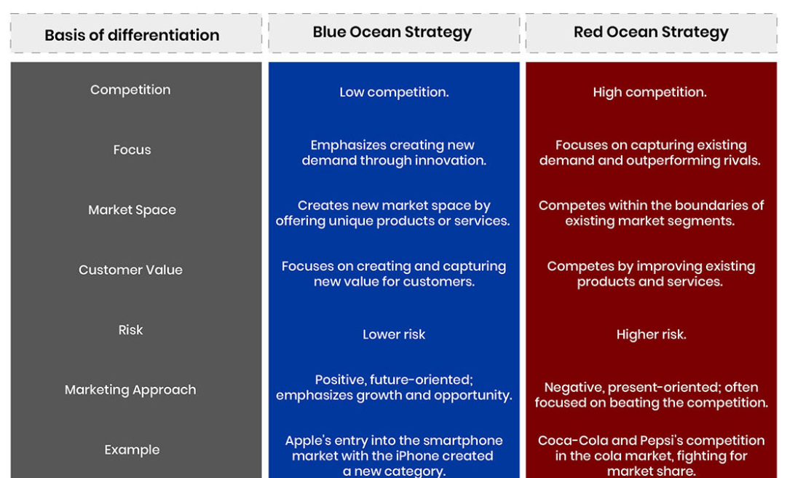
Blue Ocean Strategy
Notes:
Understanding the Red Ocean vs. Blue Ocean Strategies
November 30, 2023
Strategies are essential for succeeding in the business world. Companies navigate the competitive seas with the help of two essential approaches: the Red Ocean and Blue Ocean strategies. The Red Ocean strategy emphasizes competition and gradual improvements while taking on established competitors in a well-known market. On the other hand, the Blue Ocean strategy stimulates businesses to venture into uncharted territory, establishing new markets through creative thinking and originality. These strategic decisions set the direction for a company's journey through the vast ocean of business opportunities and influence how it deals with the difficulties of competition and market development.
What is the Red Ocean Strategy and Its Benefits
The traditional business strategy known as the "Red Ocean" strategy is when businesses compete in their current markets to outperform competitors and capture a larger market share. This frequently entails emphasizing differentiation, price, or a mix of the two. The phrase "Red Ocean" refers to a metaphorical situation in which competitors are engaged in a fierce battle for the same customer base. This tactic has advantages even though it might seem obvious.
Benefits
Competes in the current market.
Outperforms the opposition.
Takes advantage of the current demand.
Makes the trade-off between value and cost.
Synchronizes a company's entire operational system with its low-cost or differentiation strategy choice.
Red Ocean Strategies and Examples
Red Ocean's strategies usually center on using well-known tactics to compete in already-established market spaces. Cost leadership, for instance, entails lowering production costs within the sector to draw in price-conscious clients. In contrast, product differentiation emphasizes providing distinctive features to make a name for yourself in a crowded market.
The fast-food market is highly competitive, with high-profile ads, aggressive pricing, and new product varieties. McDonald's is a prime example of a company that has successfully used the red ocean approach. All that McDonald's accomplished was to stay under the radar while providing excellent burgers made with fresh ingredients in a restaurant with a conventional aesthetic. When it comes to the food industry, McDonald's delivers on authenticity.
What is the Blue Ocean Strategy and Its Benefits
The Blue Ocean Strategy is an innovative marketing technique that emphasizes innovation over direct competition to revive companies. The strategy, which was first introduced in 2005 by W. Chan Kim and Renée Mauborgne, entails creating new market niches and increasing customer demand to eliminate the need for competition.
Benefits
Makes market space uncontested.
Renders the rivalry meaningless.
Generates and seizes additional requests.
Overcomes the value-cost trade-offs to achieve low cost and uniqueness by coordinating with all of a firm's operations.
Blue Ocean Strategies and Examples
Instead of competing for a piece of the market that already exists, Blue Ocean's strategies focus on generating new value for their clients. For instance, Cirque du Soleil transformed the business of circus around the world, by fusing theater and circus elements, making it appealing to a broader audience than just traditional circus visitors. By carving out a new market niche, this calculated action helped the company break away from the fierce rivalry within the established circus sector.
Meta (Formerly Facebook): CEO Mark Zuckerberg declared in October 2021 that Facebook would now go by the name Meta. When Facebook first launched, social networks were a completely new industry. After more than ten years, social networking has grown into a monopoly. By changing its name, Meta can focus its product offerings on the "metaverse," an uncharted territory that is thrilling and novel. Although the strategy shift has yet to be proven, it is clear that the idea of moving from the red ocean of social media to the blue ocean of the metaverse influenced the decision.
Blue Ocean vs. Red Ocean Strategy: Main Differences
The two concepts that outline different market strategies are the Red Ocean Strategy and the Blue Ocean Strategy. Here's a table comparing them:

Slide 11
Strategic Management Process
Strategic management is the process of assessing “what we are” and deciding and implementing “what we intend to be’’ and “ how we are going to get there”.
The typical sequence of activities of the management process are:
  Review and define the organizational mission.
  Analyze and formulate strategies.
  Set objectives to achieve strategy.
  Implement strategies through projects.
strategic
Notes:
Review and define or anizational mission:
Mission identifies “what we want to become.”
Mission statement identifies scope of organization in terms of its product and service.
Anal ze and formulate strateoies:
Formulatin strate answers question of “what answers question of “what
Se ob e i es o a hie e s a e ies
Objectives translate organization strategy into specific,
concrete, measurable terms.
Objectives answer in detail h o
headed" and Uhh n
It is a continuous, iterative process aim to develop integrated and coordinated long-term plan of action.
Requires strong links among items, such as:
\• mission (message/scope),
\• strategy (long-term plan of action),
\• goals (long-term aim),
\• objectives (time-based milestones), and
\• implementation.

Slide 12
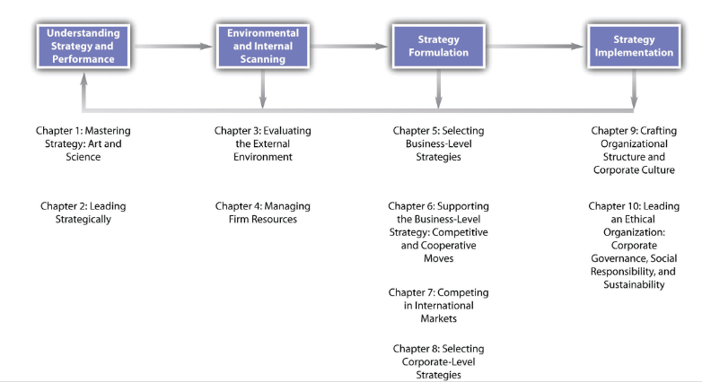
Notes:
The strategic management process begins with an understanding of strategy and performance. As we have noted in this introductory chapter, strategic management is both an art and a science, and it involves multiple conceptualizations of the notion of strategy drawn from recent and ancient history. In Chapter 2 "Leading Strategically", we focus on how leading strategically is needed if the firm is to achieve the long-term strong performance companies such as Apple have attained. Consequently, how managers understand and interpret the performance of their firms is often central to understanding strategy.
Environmental and internal scanning is the next stage in the process. Managers must constantly scan the external environment for trends and events that affect the overall economy, and they must monitor changes in the particular industry in which the firm operates. For example, Apple’s decision to create the iPhone demonstrates its ability to interpret that traditional industry boundaries that distinguished the cellular phone industry and the computer industry were beginning to blur. At the same time, firms must evaluate their own resources to understand how they might react to changes in the environment. For example, intellectual property is a vital resource for Apple. Between 2008 and 2010, Apple filed more than 350 cases with the US Patent and Trademark Office to protect its use of such terms as apple, pod, and safari.Apple Inc. litigation. Wikipedia. Retrieved from en.wikipedia.org/wiki/Apple_Inc._ litigation
A classic management tool that incorporates the idea of scanning elements both external and internal to the firm is SWOT (strengths, weaknesses, opportunities, and threats) analysis. Strengths and weaknesses are assessed by examining the firm’s resources, while opportunities and threats refer to external events and trends. The value of SWOT analysis parallels ideas from classic military strategists such as Sun Tzu, who noted the value of knowing yourself as well as your opponent. Chapter 3 "Evaluating the External Environment" examines the topic of evaluating the external environment in detail, and Chapter 4 "Managing Firm Resources" presents concepts and tools for managing firm resources.
The importance of knowing yourself and your opponent is applicable to the knowledge of strategic management for business, military strategy, and classic strategy games such as chess.
Strategy formulation is the next step in the strategic management process. This involves developing specific strategies and actions. Certainly, part of Apple’s success is due to the unique products it offers the market, as well as how these products complement one another. A customer can buy an iPod that plays music from iTunes—all of which can be stored in Apple’s Mac computer.Inside CRM Editors. Effective strategies Apple uses to create loyal customers [Online article]. Retrieved from http://www.insidecrm.com/features/strategies-apple-loyal -customers In Chapter 5 "Selecting Business-Level Strategies", we discuss how selecting business-level strategies helps to provide firms with a recipe that can be followed that will increase the likelihood that their strategies will be successful. In Chapter 6 "Supporting the Business-Level Strategy: Competitive and Cooperative Moves", we present insights on how firms can support the business-level strategy through competitive and cooperative moves. Chapter 7 "Competing in International Markets" presents possibilities for firms competing in international markets, and Chapter 8 "Selecting Corporate-Level Strategies" focuses on selecting corporate-level strategies.
Strategy implementation is the final stage of the process. One important element of strategy implementation entails crafting an effective organizational structure and corporate culture. For example, part of Apple’s success is due to its consistent focus on innovation and creativity that Steve Jobs described as similar to that of a start-up. Chapter 9 "Executing Strategy through Organizational Design" offers ideas on how to manage these elements of implementation. The final chapter explores how to lead an ethical organization through corporate governance, social responsibility, and sustainability.
Key Takeaway
Strategic management is a process that requires the ability to manage change. Consequently, executives must be careful to monitor

Slide 13
It is a continuous, iterative process aim to develop integrated and coordinated long-term plan of action.
Requires strong links among items, such as:
• mission (message/scope),
• strategy (long-term plan of action),
• goals (long-term aim),
• objectives (time-based milestones), and
• implementation

Slide 14
Strategic Management Process
Two Maior Dimensions of Strategic Management:
Internal responses to new action programs: aimed at enhancinq competitive position of organization.
Response to changes in external environment: allocates scarce (unique) resources of organization to imgrove its competitive position.

Slide 15
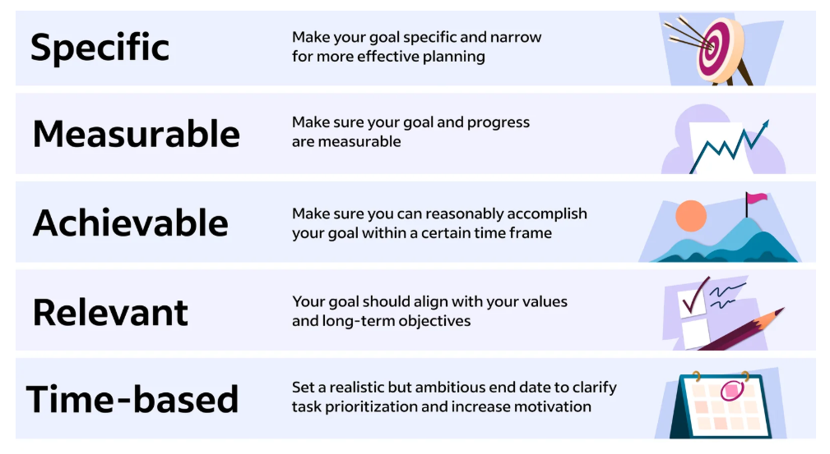
Characteristics of Objectives: SMART
S M | Specific Measurable | Be specific when settinq objective. Establish a measurable indicator(s) of progress.
A | Assignable | Make objective assignable to one person for
 |  | completion.
R | Realistic | State what can realistically be done with available resources.
T | Time related | State when objective can be achieved, that is, duration.
Dr. Murvy Badi
8
Notes:
Specific: What really needs to be accomplished? Limit resolutions and PRIORITIZE!
Measurable: Before you begin, establish milestones and keep track of them.
Achievable: Be honest—is the resolution reasonable? Perhaps start with a smaller goal.
Relevant: Ask yourself why you are setting this goal. Is it important enough to motivate you to achieve it?
Time-bound: Set realistic time frames to achieve your goals.

Slide 16

Mission
Mission statements identify the scope of the organization in terms of its product or service. “what we want to become”.
A mission statement is like a road map of how to achieve the organization goals. It defines the purpose of the organization.
It consists of :
  The impact or the change that the company wants to create.
  How the company will create that change or impact.
Typically, one or two sentences, that defines why the organization exists, especially what it offers to its customers and clients

Slide 17
Examples
GOOGLE’s mission: “to organize the world's information and make it
universally accessible and useful”
How
Impact
SOUTHWEST AIRLINES’s mission: “Connect People to what's
important in their lives through friendly, reliable, and low-cost air travel”.
How
Impact
LINKEDIN’s mission: “connect the world's professionals to make them more productive and successful”.
How
Impact

Slide 18
1- Review and define the organizational mission
Mission statements change infrequently. However, when the nature of the business changes or shifts, a revised mission statement may be required.
Everyone in the organization should be keenly aware of the organization’s mission
Example: ‘‘Apple is committed to bringing the best personal computing experience to students, educators, creative professionals and consumers around the world through its innovative hardware, software and Internet offerings’’.

Slide 19
2- Analyze and formulate strategies
Formulating strategy answers the question of what needs to be done to reach the mission. Strategy formulation includes determining and evaluating alternatives that support the organization’s objectives and selecting the best alternative
The first step is a realistic evaluation of the past and current position of the enterprise. This step typically includes an analysis of “who are the customers” and “what are their needs as they (the customers) see them.”
The next step is an assessment of the internal and external environments (SWOT).
The keys are to attempt to forecast fundamental industry changes and stay in a proactive mode rather than a reactive one
Next
Strategy formulation ends with cascading objectives or projects assigned to lower divisions, departments, or individuals. Formulating strategy might range around 20% of management’s effort, while determining how strategy will be implemented might consume 80%.
Step

Slide 20
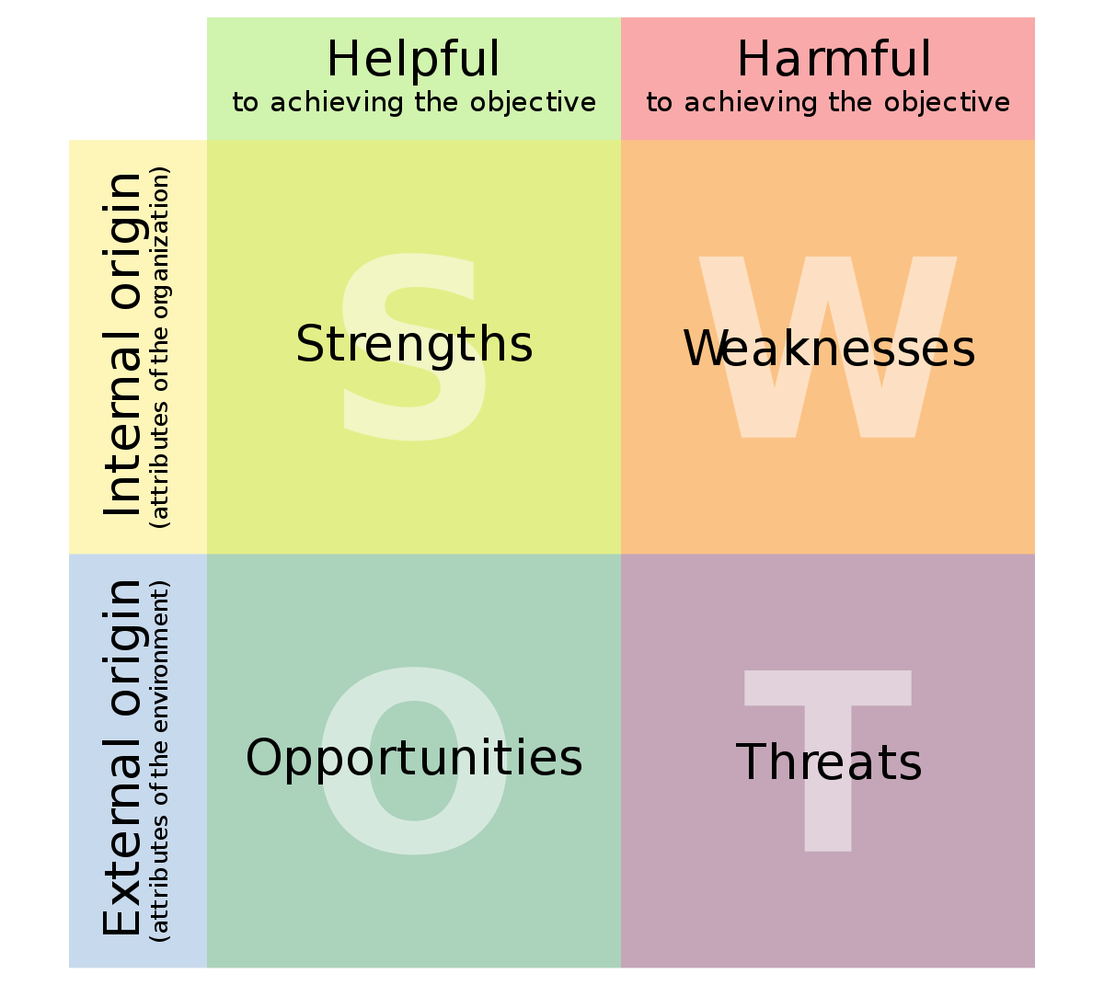
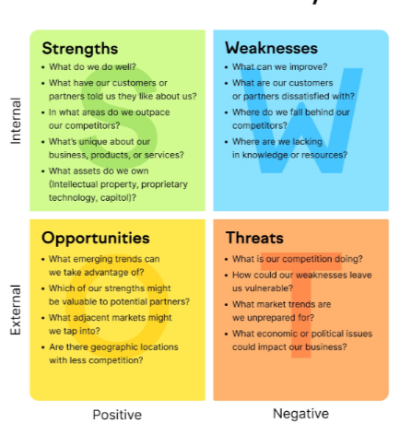
SWOT Analysis
Notes:
Strengths: Internal attributes that contribute positively to achieving goals. For students, these could include skills, knowledge, and personal traits.
Weaknesses: Internal factors that hinder progress. These might be areas where students need improvement or lack resources.
Opportunities: External factors that can be leveraged for success. These include trends, events, or circumstances that can be beneficial.
Threats: External factors that could cause problems or obstacles. These might be competition, changes in the academic environment, or personal challenges

Slide 21
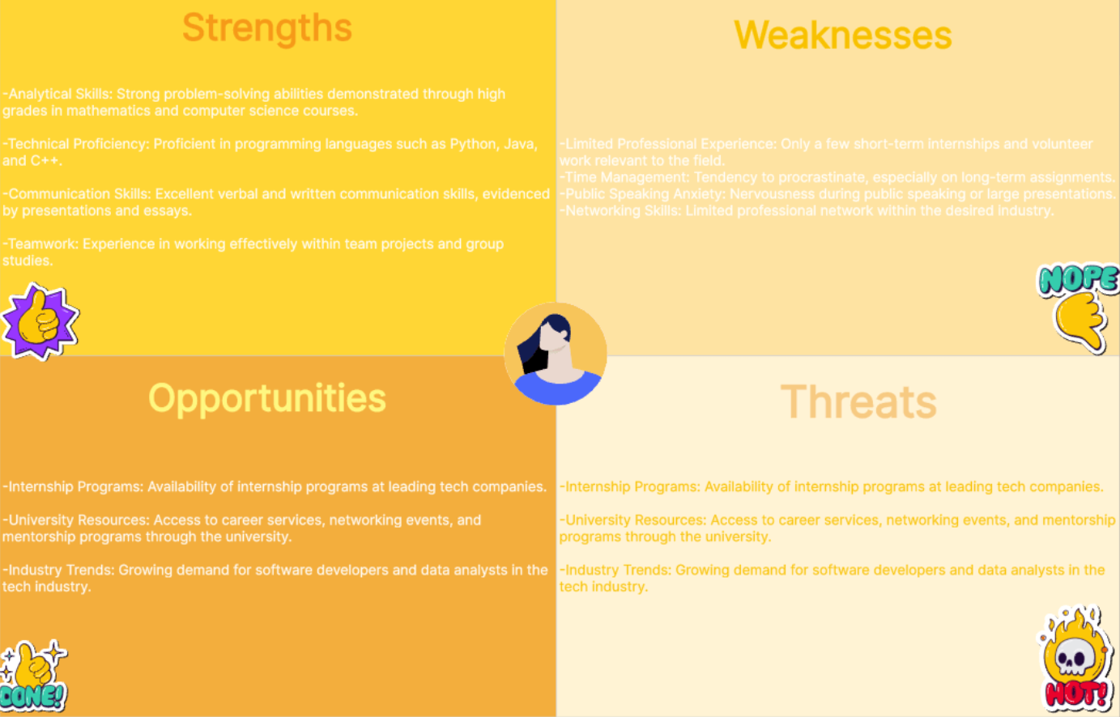
Notes:
Example 1: Undergraduate Student Seeking Internship
Strengths✨✨:
-Analytical Skills: Strong problem-solving abilities demonstrated through high grades in mathematics and computer science courses.
-Technical Proficiency: Proficient in programming languages such as Python, Java, and C++.
-Communication Skills: Excellent verbal and written communication skills, evidenced by presentations and essays.
-Teamwork: Experience in working effectively within team projects and group studies.
Weaknesses:
-Limited Professional Experience: Only a few short-term internships and volunteer work relevant to the field.
-Time Management: Tendency to procrastinate, especially on long-term assignments.
-Public Speaking Anxiety: Nervousness during public speaking or large presentations.
-Networking Skills: Limited professional network within the desired industry.
Opportunities:
-Internship Programs: Availability of internship programs at leading tech companies.
-University Resources: Access to career services, networking events, and mentorship programs through the university.
-Industry Trends: Growing demand for software developers and data analysts in the tech industry.
Threats:
-High Competition: Intense competition for internship positions at top companies.
-Rapid Technological Change: Need to continuously update skills to keep up with fast-evolving technology.
-Economic Factors: Potential economic downturn affecting hiring rates and internship availability.
Example 2: High School Student Preparing for College Applications
Strengths✨✨:
-Academic Performance: High GPA and strong performance in advanced placement (AP) courses.
-Leadership: Leadership roles in student government and other school organizations.
-Resilience: Ability to handle academic and personal challenges effectively.
Weaknesses:
-Standardized Testing: Moderate scores on SAT/ACT compared to peers.
-Volunteering: Limited volunteer and community service experience.
-Application Skills: Lack of experience in writing college application essays and preparing for interviews.
Opportunities:
-Scholarships: Various scholarships are available for students with strong academic and extracurricular records.
-Networking: Opportunities to connect with alumni and professionals through school events and online platforms.
-Mentorship: Availability of mentorship programs to guide through the college application process.
Threats:
-Increasing Competition: Rising number of applicants to top-tier colleges.
-Financial Constraints: Potential financial challenges in affording out-of-state or private colleges.
-Admission Policies: Changing admission policies and criteria due to external factors like the pandemic.

Slide 22
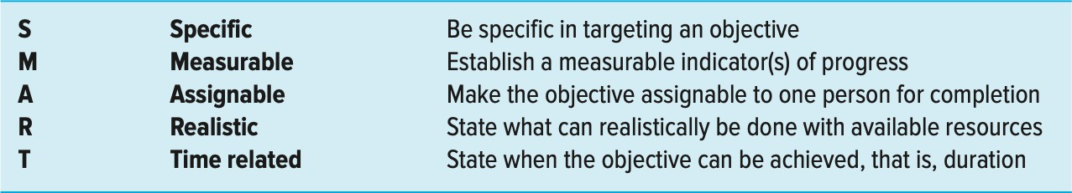
3- Set objectives to achieve strategy
Objectives translate the organization strategy into specific, concrete, measurable terms.
Organizational objectives set targets for all levels of the organization
Characteristics of Objectives

Slide 23
4- Implement strategies through projects
Implementation answers the question of how strategies will be realized, given available resources
Implementation requires action and completing tasks; the latter frequently means mission-critical projects
Although the strategy implementation process is not as clear as strategy formulation, all managers realize that, without implementation, success is impossible

Slide 24
Strategy formulation ends with cascading objectives or projects assigned to lower divisions, departments, or individuals.
Formulating strategy might range around 20%
of management’s effort, while determining how strategy will be implemented might consume 80%

Slide 25
Why the Need for a Project Priority System ?
The Implementation Gap: lack of understanding and consensus of organization strategy among top and middle-level managers.
Organization Politics: Politics exist in every organization and can have a significant influence on which projects receive funding and high priority. This is especially true when the criteria and process for selecting projects are ill-defined and not aligned with the mission of the firm
Resource Conflicts and Multitasking: Most project organizations exist in a multiproject environment. This environment creates the problems of project interdependency and the need to share resources

Slide 26
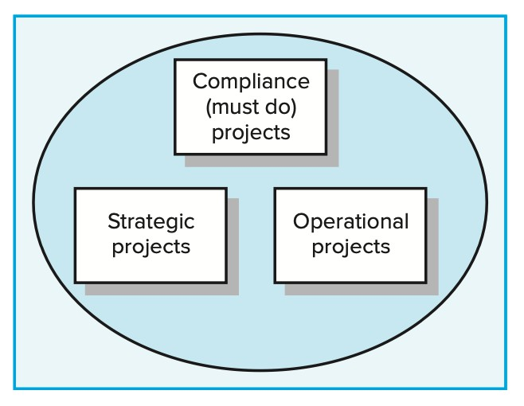
Classification of the Project
Compliance / Emergency projects are typically those needed to meet regulatory conditions required to operate in a region or emergency projects such as rebuilding a factory destroyed by fire. These projects have penalties if they are not implemented.
Operational projects are those that are needed to support current operations. These projects are designed to improve efficiency of delivery systems, reduce product costs, and improve performance.
Strategic projects are those that directly support the organization’s long-run mission. They frequently are directed toward increasing revenue or market share. Examples of strategic projects are new products, research and development.
18

Slide 27
Project Selection Criteria (1/6)
Any project placed in the “must do” category ignores other selection criteria. All other projects are selected using selection criteria linked to organization strategy. Selection criteria are typically identified as financial and nonfinancial.
Financial return, while important, does not always reflect strategic importance. A firm may support projects that do not have high profit margins for other strategic reasons including:
  Capture larger market share.
  Make it difficult for competitors to enter the market.
  Develop core technology that will be used in next-generation products.
  Reduce dependency on unreliable suppliers.
  Restore corporate image or enhance brand recognition.
  Develop an enabler product, which by its introduction will increase sales in more profitable products
19

Slide 28
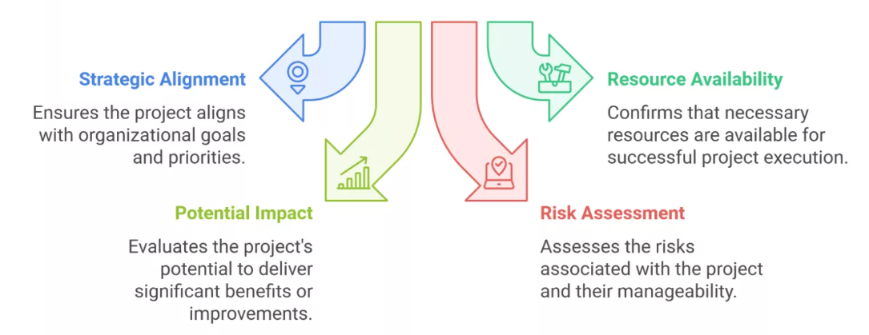

Slide 29
Project Selection Criteria (2/6)
Two Multi-Criteria Selection Models can be used:
  Checklist Models
This approach basically uses a list of questions to review potential projects and to determine their acceptance or rejection. Examples: Who is the project sponsor? What is the estimated cost of the project? What is the impact of not doing this project? What is the value of the project to this organization? When will the project show results? Will internal resources be available for this project? How long will this project take? Will staff training be required?
They allow great flexibility in selecting among many different types of projects and are easily used across different divisions and locations.
Major shortcomings of this approach are that it fails to answer the relative importance or value of a potential project to the organization and fails to allow for comparison with other potential projects. Each potential project will have a different set of positive and negative answers. How do you compare?. This approach also leaves the door open to the potential opportunity for power plays, politics, and other forms of manipulation.
20

Slide 30
Project Selection Criteria (3/6)
Multi-Weighted Scoring Models:
  It typically uses several weighted selection criteria to evaluate project proposals.
  Each selection criterion is assigned a weight. Scores are assigned to each criterion for the project, based on its importance to the project being evaluated. The weights and scores are multiplied to get a total weighted score for the project. Using these multiple screening criteria, projects can then be compared using the weighted score. Projects with higher weighted scores are considered better.
  Failure to pick the right factors will render the screening process “useless” in short order
21

Slide 31
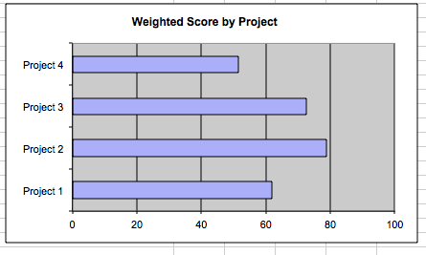
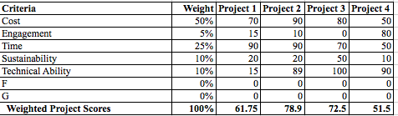
Project Selection Criteria (4/6)
x
Example 1

Slide 32
Project Selection Criteria (6/6)
While selection models like Multi-Weighted Scoring Models may yield numerical solutions to project selection decisions, models should not make the final decisions—the people using the models should.
No model, no matter how sophisticated, can capture the total reality it is meant to represent. Models are tools for guiding the evaluation process so that the decision makers will consider relevant issues and reach a meeting of the minds as to which projects should be supported and not supported. This is a much more subjective process than calculations suggest.

Slide 33
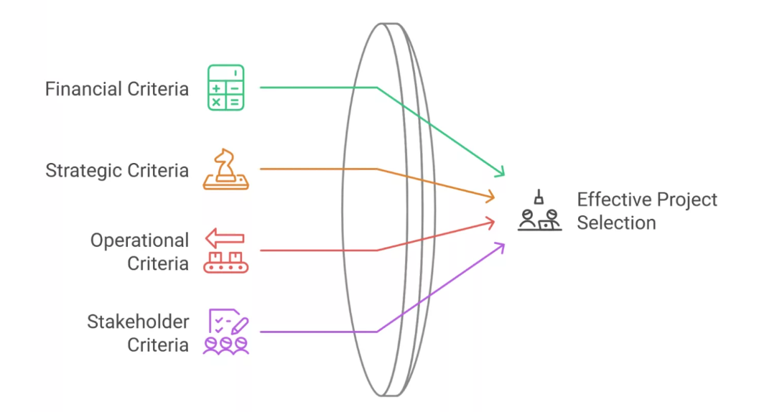
Types of Project Selection Criteria

Slide 34
Types of Project Selection Criteria
Financial Criteria
  Return on Investment (ROI)
  Net Present Value (NPV)
  Payback period
  Cost-benefit ratio
Strategic Criteria
  Alignment with organizational goals
  Market positioning
  Competitive advantage
  Long-term sustainability
Operational Criteria
  Resource availability
  Technical feasibility
  Implementation complexity
  Risk assessment
Stakeholder Criteria
  Customer impact
  Employee engagement
  Regulatory compliance
  Social responsibility

Slide 35
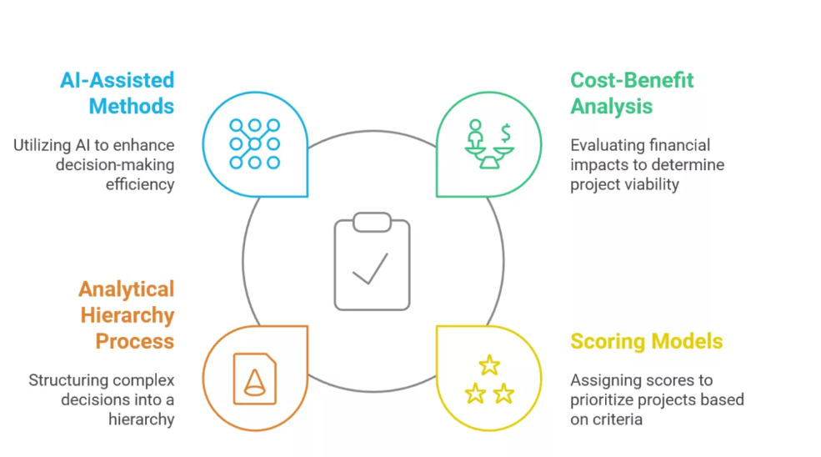
Notes:
Cost-Benefit Analysis
The cost-benefit analysis remains one of the most reliable project selection methods I’ve used throughout my career. Refine this approach to include both quantitative and qualitative factors.
Here’s a practical example from my consulting work:
When helping a manufacturing client evaluate a new automation project, we analyzed:
Initial investment: $2.5M
Annual labor savings: $800K
Quality improvement savings: $400K
Maintenance costs: $150K/year
Training requirements: $100K
The ROI calculation showed a 3-year payback period, but we also considered intangible benefits like improved employee satisfaction and reduced safety risks. I’ve found that successful cost-benefit analyses must look beyond pure numbers.
Scoring Models
In our workshops, I often emphasize that scoring models are particularly effective for comparing dissimilar projects.
Step-by-Step Guide to Creating a Scoring Model:
Identify key criteria (strategic alignment, risk, resource requirements)
Assign weights to each criterion (typically 1-5)
Develop scoring scales (1-10) for each criterion
Create evaluation matrices
Calculate weighted scores
Analytical Hierarchy Process (AHP)
The AHP method has been particularly valuable in complex decision-making scenarios. During a project, we used AHP to prioritize R&D projects, resulting in a 40% improvement in project success rates.
Case Study: Technology Investment at a technology company
We used AHP to evaluate competing infrastructure projects:
Criteria: Technical feasibility, market potential, resource availability
Alternatives: Three different technology platforms
Outcome: Selected project delivered 25% higher ROI than the historical average
Emerging Trends: AI-Assisted Selection Methods
Having worked with cutting-edge technologies throughout my career, I’m particularly excited about AI’s role in project selection.
Key AI Applications in Project Selection:
Predictive analytics for project success probability
Pattern recognition in historical project data
Risk assessment automation
Resource optimization algorithms
However, I always caution my clients that AI should complement, not replace, human judgment. The most effective approach I’ve found is a hybrid model that combines:
AI-driven data analysis
Traditional selection methods
Expert judgment
Stakeholder input
Pro Tip: When implementing AI-assisted methods, start with a pilot program focusing on smaller, less critical projects to build confidence in the system.
Master the essential tools for effective project selection and analysis.
Start Learning
Lean Six Sigma Green Belt certification equips you with practical skills in process mapping, C&E Matrix, FMEA, and more.
The Project Selection Process
Having led countless Six Sigma deployments across organizations, I’ve learned that a structured project selection process is crucial for success.

Slide 36
Assignment 1
Define a project. What are 5 characteristics that help differentiate projects from other functions carried out in the daily operations of the organization?
The technical and sociocultural dimensions of project management are two sides to the same coin. Explain.
Describe the major components of the strategic management process
Why should an organization not rely only on financial criteria to select projects?
Discuss the pros and cons of the checklist versus the weighted factor method of selecting projects.

